Slide 1
Embedded Computer Systems

Slide 2
Digital System v. Embedded System
Digital System: may provide service
  as a self-contained unit (e.g., desktop PC)
  as part of a larger system (e.g., digital control system for manufacturing plant)
Embedded System:
  part of a larger unit
  provides dedicated service to that unit
G. De Micheli and R. Gupta, “Hardware/Software Co-Design,” Proceedings of the IEEE, 85(3), March 1997, pp. 349-365

Slide 3


Embedded Systems Overview
Computing systems are everywhere
Most of us think of “desktop” computers
  PC’s
  Laptops
  Mainframes
  Servers
But there’s another type of computing system
  Far more common...
F. Vahid and T. Givargis, Embedded System Design: A Unified Hardware/Software Introduction, John Wiley & Sons, 2002.

Slide 4



Embedded Systems Overview (cont.)
Embedded computing systems
  Computing systems embedded within electronic devices
  Hard to define. Nearly any computing system other than a desktop computer
  Billions of units produced yearly, versus millions of desktop units
  Perhaps 100s per household and per automobile
Computers are in here...
and here...
and even here...
Lots more of these, though they cost a lot less each.

Slide 5
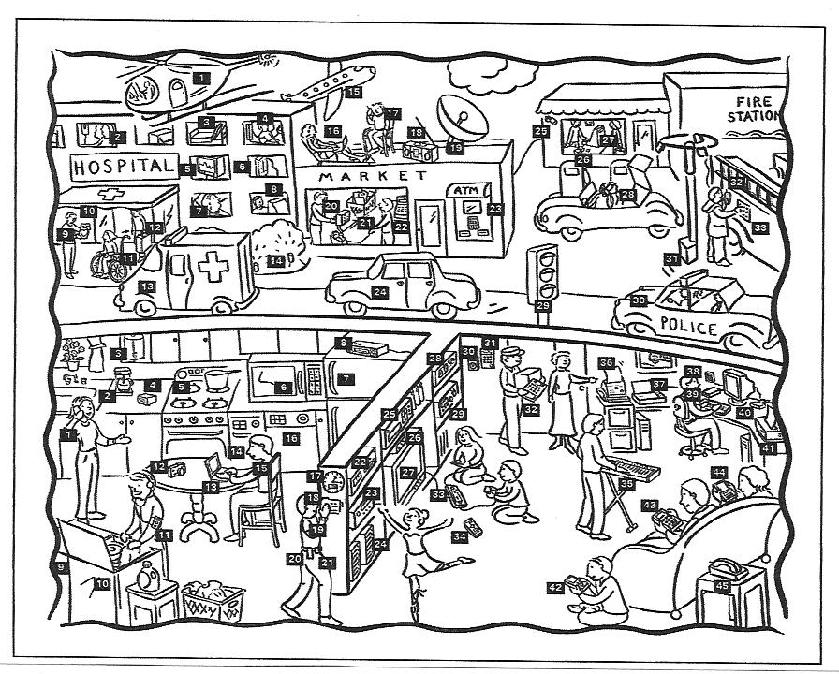

Slide 6




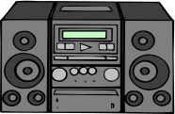




A “Short List” of Embedded Systems
Anti-lock brakes
Auto-focus cameras
Automatic teller machines
Automatic toll systems
Automatic transmission
Avionic systems
Battery chargers
Camcorders
Cell phones
Cell-phone base stations
Cordless phones
Cruise control
Curbside check-in systems
Digital cameras
Disk drives
Electronic card readers
Electronic instruments
Electronic toys/games
Factory control
Fax machines
Fingerprint identifiers
Home security systems
Life-support systems
Medical testing systems
Modems
MPEG decoders
Network cards
Network switches/routers
On-board navigation
Pagers
Photocopiers
Point-of-sale systems
Portable video games
Printers
Satellite phones
Scanners
Smart ovens/dishwashers
Speech recognizers
Stereo systems
Teleconferencing systems
Televisions
Temperature controllers
Theft tracking systems
TV set-top boxes
VCR’s, DVD players
Video game consoles
Video phones
Washers and dryers
And the list goes on and on

Slide 7
Examples of Embedded Systems
PC having dedicated software programs and appropriate interfaces to a manufacturing assembly line
Microprocessor dedicated to a control function in a computer, e.g., keyboard/mouse input control

Slide 8
Outline
Embedded systems overview
Design challenge – optimizing design metrics
Technologies
  Processor technologies
  Design technologies
Generic codesign methodology

Slide 9
Some Application Domains
CONSUMER PRODUCTS
  Appliances, Games, A/V, Intelligent home devices
TRANSPORTATION
  Autos, Trains, Ships, Aircrafts
PLANT CONTROL
  Manufacturing, Chemical, Power Generation
NETWORKS
  Telecommunication, Defense
Local
  e.g., appliance
Locally distributed
  e.g., aircraft control over a LAN
Geographically distributed
  e.g., telephone network

Slide 10
Parts of an Embedded System
USER
EMBEDDED SYSTEM
I/O
MEMORY
PROCESSOR
SENSORS
ACTUATORS
HARDWIRED UNIT
Application-specific logic
Timers
A/D and D/A conversion
ENVIRONMENT

Slide 11
Parts of an Embedded System (cont.)
Actuators - mechanical components (e.g., valve)
Sensors - input data (e.g., accelerometer for airbag control)
Data conversion, storage, processing
Decision-making
Range of implementation options
Single-chip implementation: system on a chip

Slide 12
Functions and Design Criteria
Monitoring and control functions for the overall system (e.g., vehicle control)
Information-processing functions (e.g., telecommunication system -- data compression, routing, etc.)
Criteria: performance, reliability, availability, safety, usability, etc.

Slide 13
Some Common Characteristics
Single-functioned
  Executes a single program, repeatedly
Tightly-constrained
  Low cost, low power, small, fast, etc.
Reactive and real-time
  Continually reacts to changes in the system’s environment
  Must compute certain results in real-time without delay

Slide 14
An Embedded System Example
Digital Camera
Digital camera chip
CCD
A2D
CCD preprocessor
Pixel coprocessor
D2A
lens
JPEG codec
Microcontroller
Multiplier/Accum
DMA controller
Display ctrl
Memory controller
ISA bus interface
UART
LCD ctrl
Single-functioned -- always a digital camera
Tightly-constrained -- Low cost, low power, small, fast
Reactive and real-time -- only to a small extent

Slide 15
Design Challenge – Optimization
Obvious design goal:
  Construct an implementation with desired functionality
Key design challenge:
  Simultaneously optimize numerous design metrics
Design metric
  A measurable feature of a system’s implementation
  Optimizing design metrics is a key challenge

Slide 16
Design Challenge – Optimization (cont.)
Common metrics
  Unit cost: the monetary cost of manufacturing each copy of the system, excluding NRE cost
  NRE cost (Non-Recurring Engineering cost): The one-time monetary cost of designing the system
  Size: the physical space required by the system
  Performance: the execution time or throughput of the system
  Power: the amount of power consumed by the system
  Flexibility: the ability to change the functionality of the system without incurring heavy NRE cost

Slide 17
Design Challenge – Optimization (cont.)
Common metrics (continued)
  Time-to-prototype: the time needed to build a working version of the system
  Time-to-market: the time required to develop a system to the point that it can be released and sold to customers
  Maintainability: the ability to modify the system after its initial release
  Correctness, safety, many more

Slide 18
Design Metric Competition
Expertise with both software and hardware is needed to optimize design metrics
  Not just a hardware or software expert, as is common
  A designer must be comfortable with various technologies
Power
Performance
Size
NRE cost
CCD
Digital camera chip
A2D
CCD preprocessor
Pixel coprocessor
D2A
lens
JPEG codec
Microcontroller
Multiplier/Accum
DMA controller
Display ctrl
Hardware
Software
Memory controller
ISA bus interface
UART
LCD ctrl

Slide 19
Time-to Market
Time required to develop a product to the point it can be sold to customers
Market window
  Period during which the product would have highest sales
Average time-to-market constraint is about 8 months
Delays can be costly
Revenues ($)
Time (months)

Slide 20
Delayed Market Entry
Simplified revenue model
  Product life = 2W, peak at W
  Time of market entry defines a triangle, representing market penetration
  Triangle area equals revenue
Loss
  The difference between the on-time and delayed triangle areas
Peak revenue
Peak revenue from delayed entry
On-time
Revenues ($)
Market rise
Market fall
Delayed
D
W
2W
On-time Delayed
entry entry
Time

Slide 21
NRE and Unit Cost Metrics
Costs:
  Unit cost: the monetary cost of manufacturing each copy of the system, excluding NRE cost
  NRE cost (Non-Recurring Engineering cost): the one-time monetary cost of designing the system
  total cost = NRE cost + unit cost * # of units
  per-product cost = total cost / # of units
  = (NRE cost / # of units) + unit cost
Example
  NRE=$2000, unit=$100
  For 10 units
    total cost = $2000 + 10*$100 = $3000
    per-product cost = $2000/10 + $100 = $300
Amortizing NRE cost over the units results in an additional $200 per unit

Slide 22
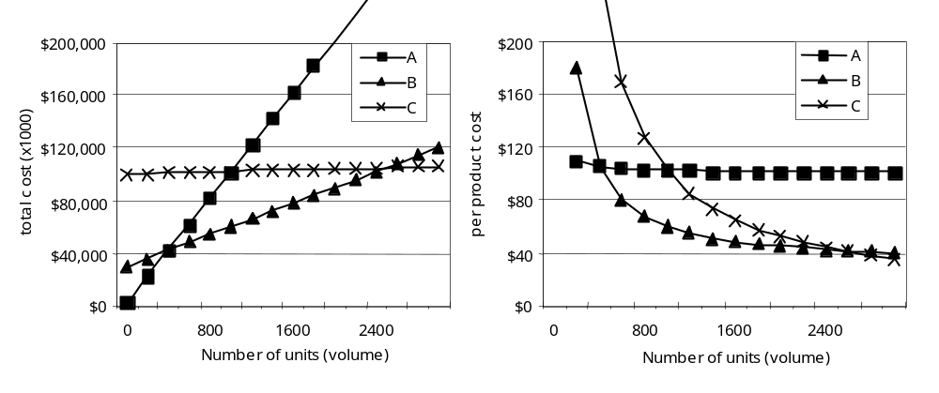
NRE and unit cost metrics
Compare technologies by costs -- best depends on quantity
  Technology A: NRE=$2,000, unit=$100
  Technology B: NRE=$30,000, unit=$30
  Technology C: NRE=$100,000, unit=$2
But, must also consider time-to-market

Slide 23
The Performance Design Metric
Widely-used measure of system, widely-abused
  Clock frequency, instructions per second – not good measures
  Digital camera example – a user cares about how fast it processes images, not clock speed or instructions per second
Latency (response time)
  Time between task start and end
  e.g., Camera’s A and B process images in 0.25 seconds
Throughput
  Tasks per second, e.g. Camera A processes 4 images per second
  Throughput can be more than latency seems to imply due to concurrency, e.g. Camera B may process 8 images per second (by capturing a new image while previous image is being stored).
Speedup of B over S = B’s performance / A’s performance
  Throughput speedup = 8/4 = 2

Slide 24
Three Key Technologies
Technology
  A manner of accomplishing a task, especially using technical processes, methods, or knowledge
Three key technologies for embedded systems
  Processor technology (CprE 581, 583, 681)
  IC technology (EE 501, 507, 511)
  Design technology (CprE 588)

Slide 25
Processor Technology
The architecture of the computation engine used to implement a system’s desired functionality
Processor does not have to be programmable
  “Processor” not equal to general-purpose processor
Controller
Datapath
Controller
Datapath
Controller
Datapath
Control
logic and State register
Register
file
Control logic and State register
Registers
Control
logic
index
total
Custom
ALU
State register
+
General
ALU
IR
PC
IR
PC
Data
memory
Data
memory
Program memory
Data
memory
Program memory
Assembly code for:
total = 0
for i =1 to …
Assembly code for:
total = 0
for i =1 to …
General-purpose (“software”)
Application-specific
Single-purpose (“hardware”)

Slide 26
Processor Technology (cont.)
Processors vary in their customization for the problem at hand
total = 0
for i = 1 to N loop
total += M[i]
end loop
Desired functionality
General-purpose processor
Application-specific processor
Single-purpose processor

Slide 27
General-Purpose Processors
Programmable device used in a variety of applications
  Also known as “microprocessor”
Features
  Program memory
  General datapath with large register file and general ALU
User benefits
  Low time-to-market and NRE costs
  High flexibility
“Intel/AMD” the most well-known, but there are hundreds of others
Controller
Datapath
Control
logic and State register
Register
file
General
ALU
IR
PC
Program memory
Data
memory
Assembly code for:
total = 0
for i =1 to …

Slide 28
Application-Specific Processors
Programmable processor optimized for a particular class of applications having common characteristics
  Compromise between general-purpose and single-purpose processors
Features
  Program memory
  Optimized datapath
  Special functional units
Benefits
  Some flexibility, good performance, size and power
Controller
Datapath
Control
logic and State register
Registers
Custom
ALU
IR
PC
Data
memory
Program memory
Assembly code for:
total = 0
for i =1 to …

Slide 29
Independence of Processor Technologies
Basic tradeoff
  General vs. custom
  With respect to processor technology or IC technology
  The two technologies are independent
General-purpose
processor
ASIP
Single-
purpose
processor
General,
providing improved:
Customized,
providing improved:
Flexibility
Maintainability
NRE cost
Time- to-prototype
Time-to-market
Cost (low volume)
Power efficiency
Performance
Size
Cost (high volume)
PLD
Semi-custom
Full-custom

Slide 30
Design Technology
The manner in which we convert our concept of desired system functionality into an implementation
Compilation/
Synthesis
Libraries/
IP
Test/
Verification
System
specification
System
synthesis
Hw/Sw/
OS
Model simulat./
checkers
Compilation/Synthesis: Automates exploration and insertion of implementation details for lower level.
Behavioral
specification
Behavior
synthesis
Cores
Hw-Sw
cosimulators
Libraries/IP: Incorporates pre-designed implementation from lower abstraction level into higher level.
RT
specification
RT
synthesis
RT
components
HDL simulators
Test/Verification: Ensures correct functionality at each level, thus reducing costly iterations between levels.
Logic
specification
Logic
synthesis
Gates/
Cells
Gate
simulators
To final implementation

Slide 31
Design Productivity Exponential Increase
100,000
10,000
1,000
100
Productivity
(K) Trans./Staff – Mo.
10
1
0.1
0.01
1981
1983
1985
1987
1989
1991
1993
1995
1997
1999
2001
2003
2005
2007
2009
Exponential increase over the past few decades

Slide 32
Design Productivity Gap
While designer productivity has grown at an impressive rate over the past decades, the rate of improvement has not kept pace with chip capacity
10,000
100,000
1,000
10,000
Logic transistors per chip
(in millions)
100
1000
10
Gap
Productivity
(K) Trans./Staff-Mo.
IC capacity
100
1
10
0.1
1
0.01
productivity
0.1
0.001
0.01
1981
1983
1985
1987
1989
1991
1993
1995
1997
1999
2001
2003
2005
2007
2009

Slide 33
Design Productivity Gap (cont.)
1981 leading edge chip required 100 designer months
  10,000 transistors / 100 transistors/month
2002 leading edge chip requires 30,000 designer months
  150,000,000 / 5000 transistors/month
Designer cost increase from $1M to $300M
10,000
100,000
1,000
10,000
Logic transistors per chip
(in millions)
100
1000
10
Gap
Productivity
(K) Trans./Staff-Mo.
IC capacity
100
1
10
0.1
productivity
1
0.01
0.1
0.001
0.01
1981
1983
1985
1987
1989
1991
1993
1995
1997
1999
2001
2003
2005
2007
2009

Slide 34
The Mythical Man-Month
The situation is even worse than the productivity gap indicates
In theory, adding designers to team reduces project completion time
In reality, productivity per designer decreases due to complexities of team management and communication
In the software community, known as “the mythical man-month” (Brooks 1975)
At some point, can actually lengthen project completion time! (“Too many cooks”)
1M transistors, 1 designer=5000 trans/month
Each additional designer reduces for 100 trans/month
So 2 designers produce 4900 trans/month each
15
Team
60000
16
16
50000
19
18
40000
24
23
30000
Months until completion
20000
43
10000
Individual
0
10
20
30
40
Number of designers

Slide 35
Co-Design Methodology
Co-design
  Design of systems involving both hardware and software components
  Starts with formal, abstract specification; series of refinements maps to target architecture: allocation, partitioning, scheduling, communication synthesis
  Means to manage large-scale, complex systems
R. Domer, D. Gajski, J. Zhu, “Specification and Design of Embedded Systems,” it+ti magazine, Oldenbourg Verlag (Germany), No. 3, June 1998.

Slide 36
Complex Systems
SOC (System-On-a-Chip)
  Millions of gates on a chip
    Decreasing processing technologies (deep sub-micron, 0.25 µm and below): decreasing geometry size, increasing chip density
  Problems
    Electronic design automation (EDA) tools
    Time-to-market

Slide 37
Complex Systems (cont.)
Abstraction
  Reduce the number of objects managed by a design task, e.g., by grouping objects using hierarchy
  Computer-aided design (CAD) example
    Logic level: transistors grouped into gates
    Register transfer level (RTL): gates grouped into registers, ALUs, and other RTL components

Slide 38
Complex Systems (cont.)
Abstraction
  Co-design example
    System level: processors (off-the-shelf or application-specific), memories, application-specific integrated circuits (ASICs), I/O interfaces, etc.
    Integration of intellectual property (IP) - representations of products of the mind
    Reuse of formerly designed circuits as core cells

Slide 39
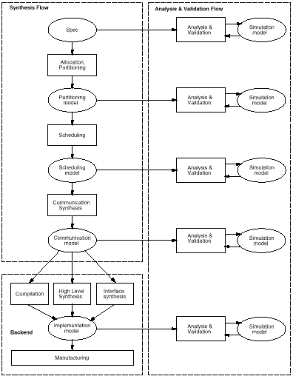
Generic Co-Design Methodology
Synthesis
Specification
Allocation
Partitioning
Scheduling
Communication
synthesis
Implementation
Software synthesis
Hardware synthesis
Interface synthesis
model
Analysis
&
Validation
Note: design
models may
be captured
in the same
language
task

Slide 40
System Specification
Describes the functionality of the system without specifying the implementation
Describes non-functional properties such as performance, power, cost, and other quality metrics or design constraints
May be executable to allow dynamic verification

Slide 41
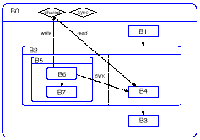
System Specification Example
B0: top
behavior
integer
variable
boolean
variable
shared
sync
child
behavior
write
read
sync
Graphical
representation:
Hierarchy
Concurrency
Transitions
between
behaviors
Behaviors
Sequential: B1, B2, B3
Concurrent: B4, B5
Atomic: B1
Composite: B2

Slide 42
System Specification Example (cont.)
Producer-
consumer
functionality
B6 computes a
value
B4 consumes the
value
Synchronization
is needed: B4
waits until B6
produces the value
shared
sync
write
read
sync

Slide 43
System Specification Example
Atomic behaviors
B1( )
{
stmt;
...
}
B3( )
{
stmt;
...
}
B7( )
{
stmt;
...
}
B6( )
{
int local;
…
shared = local + 1;
signal(sync);
}
B4( )
{
int local;
wait(sync);
local = shared - 1;
...
}

Slide 44
Allocation
Selects the type and number of components from a library and determines their interconnection
Implements functionality so as to
  Satisfy constraints
  Minimize objective cost function
Result may be customization of a generic target architecture

Slide 45
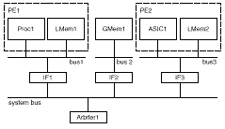
Allocation Example
PE1
PE2
Proc1
LMem1
GMem1
ASIC1
LMem2
bus1
bus2
bus3
IF1
IF2
IF3
system bus
PE: Processing Element
LMem: Local Memory
GMem: Global Memory
IF: Interface
Arbiter1
Target Architecture Model

Slide 46
Partitioning
Defines the mapping between the set of behaviors in the specification and the set of allocated components in the architecture
  Satisfy constraints
  Minimize costs
Not yet near implementation
  Multiple behaviors in a single PE (scheduling)
  Interactions between PEs (communication)
Design model
  additional level of hierarchy
  functional equivalence with specification

Slide 47
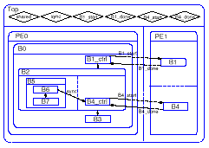
Partitioning Example
synchronization variables
Top
shared sync B1_start B1_done B4_start B4_done
PE0
PE1
controlling
behavior
Child (B1)
assigned to
different PE
than
parent (B0)
B1_start
B1_ctrl
B1_done
B4_start
B4_ctrl
B4_done
System model after partitioning

Slide 48
Partitioning Example (cont.)
Atomic behaviors
B1( )
{
wait(B1_start);
…
signal(B1_done);
}
B1_ctrl( )
{
signal(B1_start);
wait(B1_done);
}
B3( )
{
stmt;
...
}
B7( )
{
stmt;
...
}
B4( )
{
int local;
wait(B4_start);
wait(sync);
local = shared - 1;
…
signal(B4_done);
}
B4_ctrl( )
{
signal(B4_start);
wait(B4_done);
}
B6( )
{
int local;
…
shared = local + 1;
signal(sync);
}

Slide 49
Scheduling
Given a set of behaviors and optionally a set of performance constraints, determines a total order in time for invoking behaviors running on the same PE
Maintains the partial order imposed by dependencies in the functionality
Minimizes synchronization overhead between PEs and context-switching overhead within each PE

Slide 50
Scheduling
Ordering information
  Known at compile time
    Static scheduling
    Higher inter-PE synchronization overhead if inaccurate performance estimation, i.e., longer wait times and lower CPU utilization
  Unknown until runtime (e.g., data-, event-dependent)
    Dynamic scheduling
    Higher context-switching overhead (running task blocked, new task scheduled)

Slide 51
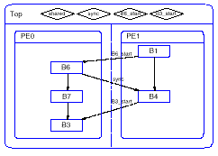
Scheduling Example
shared sync B6_start B3_start
Scheduling
decision:
Sequential
ordering of
behaviors
on PE0, PE1
Synchronization
to maintain
partial order
across Pes
Optimization - no
control behaviors
B6_start
sync
B3_start
System model after static scheduling

Slide 52
Scheduling Example (cont.)
Atomic behaviors
B1( )
{
…
signal(B6_start);
}
B3( )
{
wait(B3_start);
...
}
B7( )
{
stmt;
...
}
B6( )
{
int local;
wait(B6_start);
…
shared = local + 1;
signal(sync);
}
B4( )
{
int local;
wait(sync);
local = shared - 1;
…
signal(B3_start);
}

Slide 53
Communication Synthesis
Implements the shared-variable accesses between concurrent behaviors using an inter-PE communication scheme
  Shared memory: read or write to a shared-memory address
  Local PE memory: send or receive message-passing calls
Inserts interfaces to communication channels (local or system buses)

Slide 54
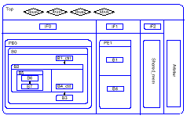
Communication example
lbus0 lbus1 lbus2 sbus
Synthesis
decision:
Put all
global
variables
into
Shared_mem
New global
variables in Top
IF0
IF1
IF2
PE0
PE1
B6
B1
Shared_mem
Arbiter
B7
B4
B3
System model after communication synthesis

Slide 55
Communication Example (cont.)
Atomic behaviors
B1( )
{
…
signal (*B6_start_addr);
}
B3( )
{
wait(*B3_start_addr);
...
}
B7( )
{
stmt;
...
}
B6( )
{
int local;
wait (*B6_start_addr);
…
*shared_addr = local + 1;
signal(*sync_addr);
}
B4( )
{
int local;
wait (*sync_addr);
local = *shared_addr - 1;
…
signal (*B3_start_addr);
}

Slide 56
Communication Example (cont.)
Atomic behaviors
IF0( )
{
stmt;
...
}
IF1( )
{
stmt;
...
}
IF2( )
{
stmt;
...
}
Arbiter( )
{
stmt;
...
}
Shared_mem( )
{
int shared;
bool sync;
bool B3_start;
bool B6_start;
}

Slide 57
Analysis and Validation
Functional validation of design models at each step using simulation or formal verification
Analysis to estimate quality metrics and make design decisions
Tools
  Static analyzer - program, ASIC metrics
  Simulator - functional, cycle-based, discrete-event
  Debugger - access to state of behaviors
  Profiler - dynamic execution information
  Visualizer - graphical displays of state, data

Slide 58
Backend
Implementations
  Processor: compiler translates model into machine code
  ASIC: high-level synthesis tool translates model into netlist of RTL components
  Interface
    Special type of ASIC that links a PE with other components
    Implements the behavior of a communication channel

Slide 59
Summary
Embedded systems are everywhere
Key challenge: optimization of design metrics
  Design metrics compete with one another
A unified view of hardware and software is necessary to improve productivity
Key technologies
  Processor: general-purpose, application-specific, single-purpose
  Design: compilation/synthesis, libraries/IP, test/verification

